Slide 1
Project 1, Module 2
Lucas Ross

Slide 2
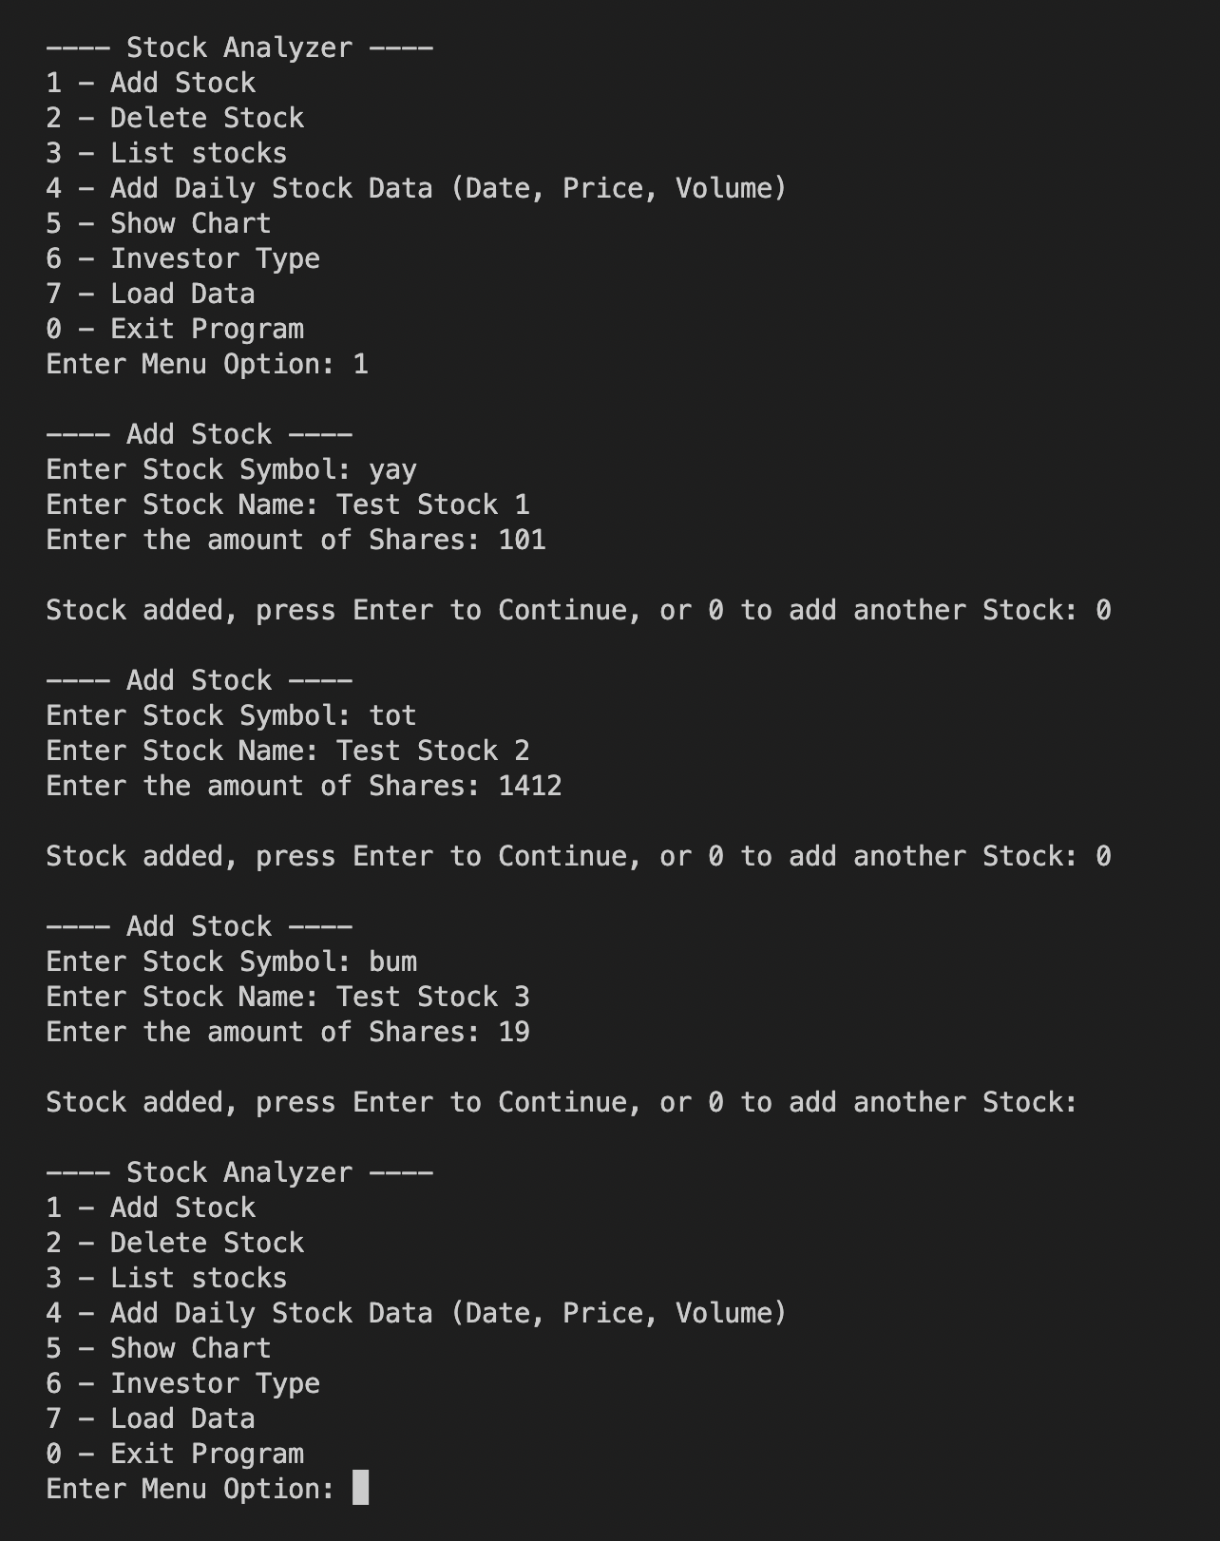
Adding a Stock
Three stocks were added to the stock inventory:
[YAY] Test Stock 1 (101 shares)
[TOT] Test Stock 2 (1412 shares)
[BUM] Test Stock 3 (19 shares)

Slide 3

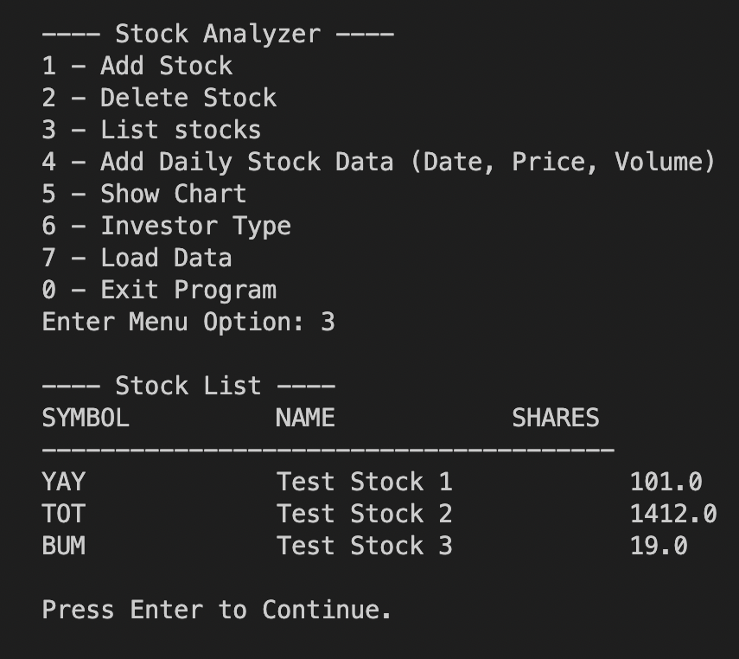
Listing 3 Stocks
The three stocks shown in the previous slide are listed here.

Slide 4
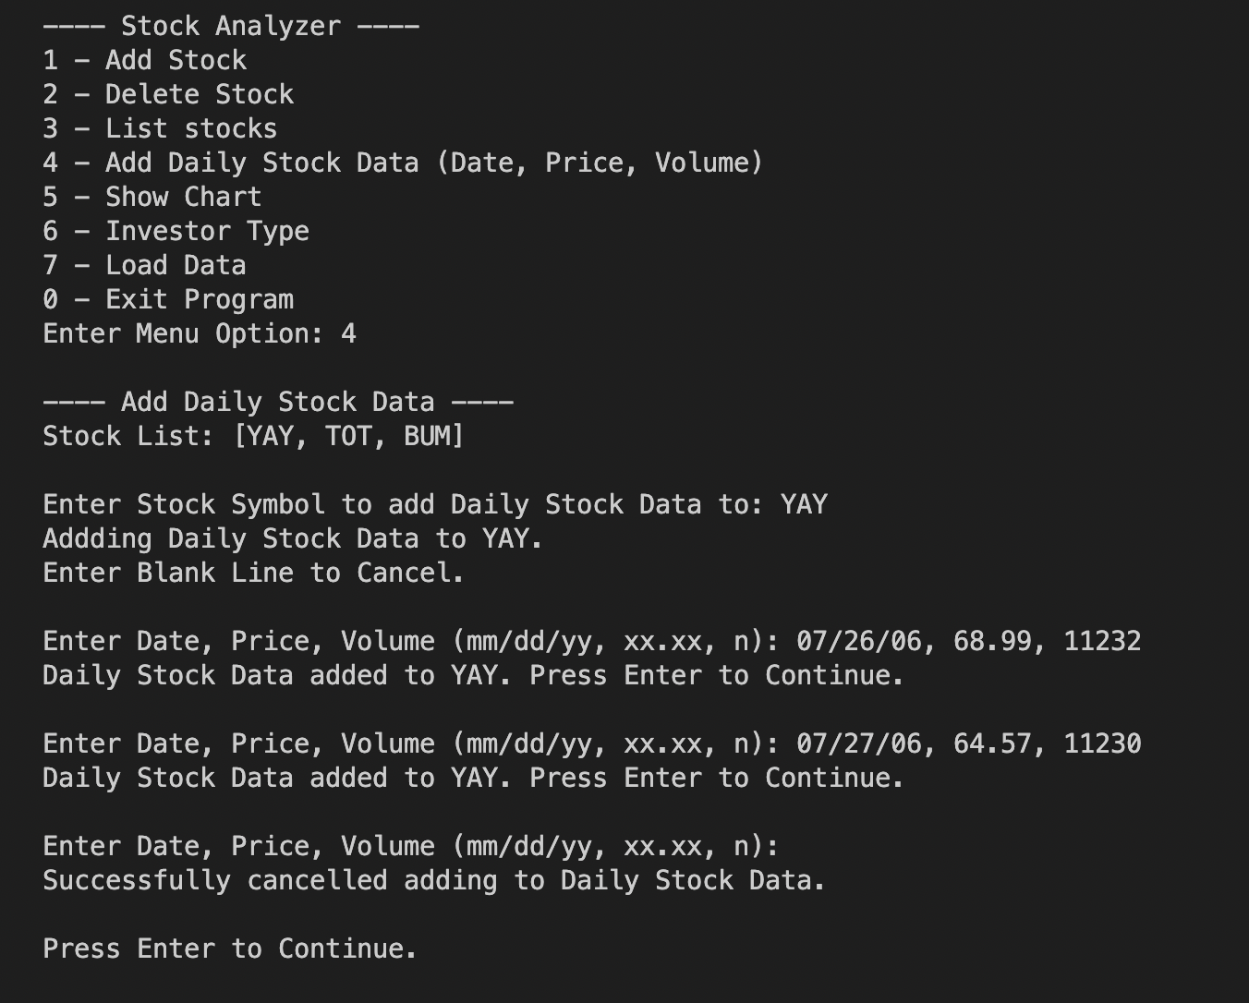
Daily Data
Two Daily Stock Data entries were added to [YAY]:
Jul. 26 2006, $68.99, 11232 units
Jul. 27 2006, $64.57, 11230 units

